Slide 1

“SocialMedia webApp
Deployment”
Task - 5

Slide 2


Your Project Name
Social media websites have revolutionized the way we communicate and interact with each other. The popularity and usage of social media platforms have grown significantly over the past decade, with millions of people using these platforms daily to connect with friends, family, and even strangers.
LMS Username | Name | Batch
2113a55306 | Dhanushmathi S | A55
2113a55317 | Joel Joseph | A55
2113a55323 | Madhumitha R | A55
2113a55330 | Padmavathi G | A55

Slide 3

Step-Wise Description
1.Prepare your code 2.Choose a hosting provider
3.Set up your hosting environment 4.Configure domain and DNS 5.Set up a database
6.Build and package your app 7.Configure security 8.Deploy your code
Install dependencies
Configure environment variables 11.Test your deployment
12.Monitor and optimize performance 13.Scale your app
Continuous deployment and updates
Monitor and respond to user feedback
Summary of your task
The deployment stage of a social media web app involves preparing the code, choosing a hosting provider, setting up the hosting environment, configuring the domain and DNS, establishing a database, building and packaging the app, implementing security measures, deploying the code, installing dependencies, and configuring environment variables. Thorough testing, performance monitoring, and optimization are conducted. Scalability measures are put in place, and a continuous deployment process is established. User feedback is monitored and used for ongoing maintenance and improvements.

Slide 4
Prepare your code:
Make sure your social media web app code is ready for deployment. This includes ensuring it is well-organized, documented, and optimized for production use.
Choose a hosting provider:
Select a hosting provider that suits your needs and budget. Popular options include Amazon Web Services (AWS), Google Cloud Platform (GCP), Microsoft Azure, or a managed hosting service like Heroku.
Set up your hosting environment:
Create an account with your chosen hosting provider and set up the necessary infrastructure. This may involve creating virtual machines, configuring networking, and setting up a database server.
Configure domain and DNS:
If you have a custom domain, configure the DNS settings to point to your hosting provider's servers. This allows users to access your web app using your domain name.

Slide 5
Set up a database:
Depending on your app's requirements, set up a database to store user data, posts, comments, and other relevant information. Choose a suitable database solution such as MySQL, PostgreSQL, MongoDB, or a managed database service provided by your hosting provider.
Build and package your app:
Prepare your app for deployment by creating a production-ready build. This may involve bundling your frontend code, optimizing assets, and setting up a build process using tools like webpack, Gulp, or npm scripts.
Configure security:
Implement security measures to protect your app and its users. This includes enabling HTTPS encryption, using secure passwords, implementing user authentication and authorization, and setting up a firewall to prevent unauthorized access.
Deploy your code:
Upload your code to the hosting environment using the provided tools or services. This may involve using Git for version control and deployment, or deploying directly from a local development environment using tools like Docker.

Slide 6
Install dependencies:
Install the necessary dependencies and libraries required for your app to run smoothly. This includes backend frameworks, frontend libraries, and any other tools or packages specified in your app's configuration files.
Configure environment variables:
Set up environment variables to store sensitive information such as API keys, database credentials, and other configuration settings. This helps to keep such information secure and allows for easy configuration changes in different environments.
Test your deployment:
Perform thorough testing to ensure your app is functioning as expected in the deployment environment. Test all the features, workflows, and integrations to catch any potential issues or bugs.
Monitor and optimize performance:
Set up monitoring tools to track the performance and health of your app. This includes monitoring server resources, database performance, response times, and user interactions. Optimize your app based on the collected data to improve its performance and scalability.

Slide 7
Scale your app:
If your social media app experiences increased traffic or user growth, be prepared to scale your infrastructure. This may involve adding more servers, increasing database capacity, or using load balancing techniques to distribute traffic.
Continuous deployment and updates:
Implement a process for continuous deployment and updates to ensure your app stays up to date with new features, bug fixes, and security patches. Use version control, automated testing, and deployment pipelines to streamline the deployment process.
Monitor and respond to user feedback:
Regularly monitor user feedback, bug reports, and analytics to understand how users are interacting with your app. Use this information to make improvements, address issues, and plan future updates.

Slide 8
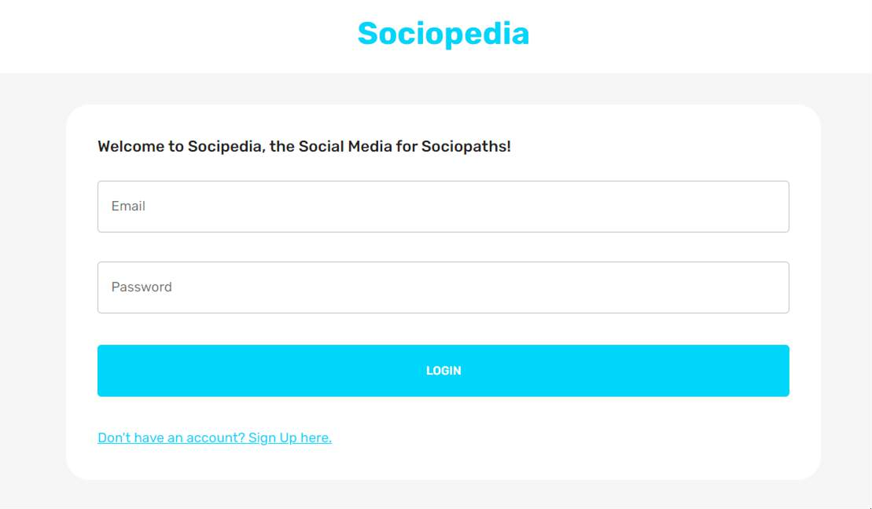
Output
Frontend – Login page

Slide 9
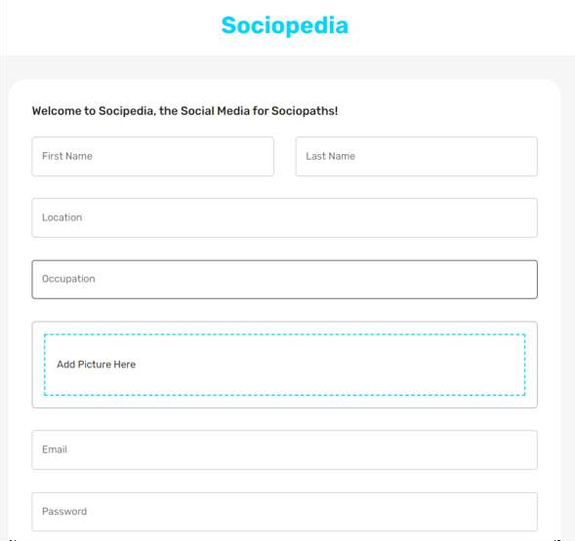
Output
Registration page

Slide 10
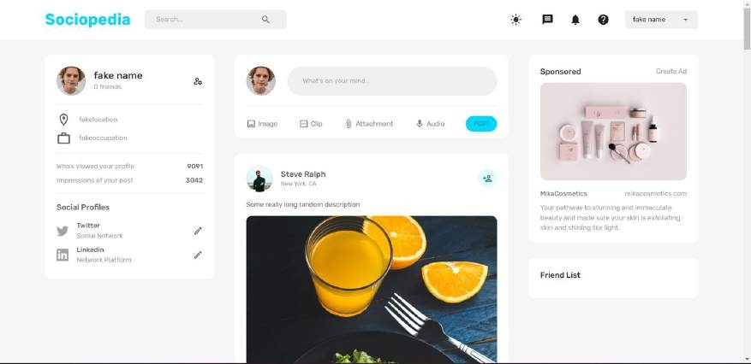
Output
Homepage

Slide 11
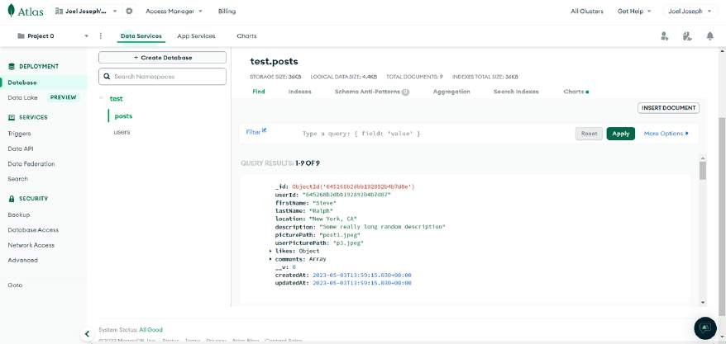
Output
Backend – Post database

Slide 12
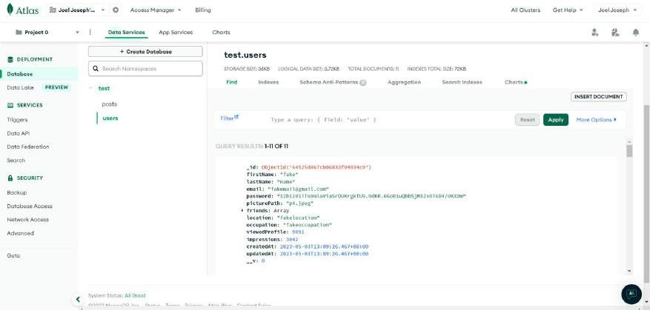
Output
User database

Slide 13
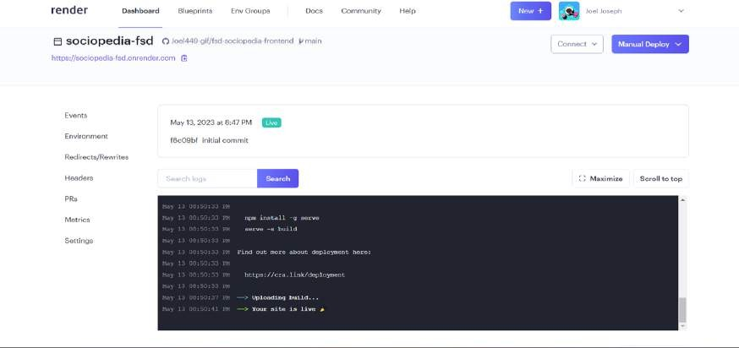
Output
Hosting the web application using Render

Slide 14


Hosted website link
https://sociopedia-
fsd.onrender.com

Slide 15
https://github.com/Joel449- gif/NM-FSD
GitHub Link

Slide 16


